Slide 1
The Impact of Social Media (Donald Trump’s tweets) on Financial Market
by Jackie, Jia, Sam, Xinrui

Slide 2
Overview:
Do Trump’s tweets impact market sentiment in a significant level?
How Trump’s tweets affect individual public company’s stock price?
Techniques we have conducted:
Time Series Analysis
Sentimental Analysis
Causal Impact Analysis
Results we have found:
Capital market performance does not necessarily obey time series
Trump’s tweets have significant impacts on public company (Pfizer, Chrysler, Toyota)’s stock price
Sentimental Index has weak correlation with financial market performance

Slide 3
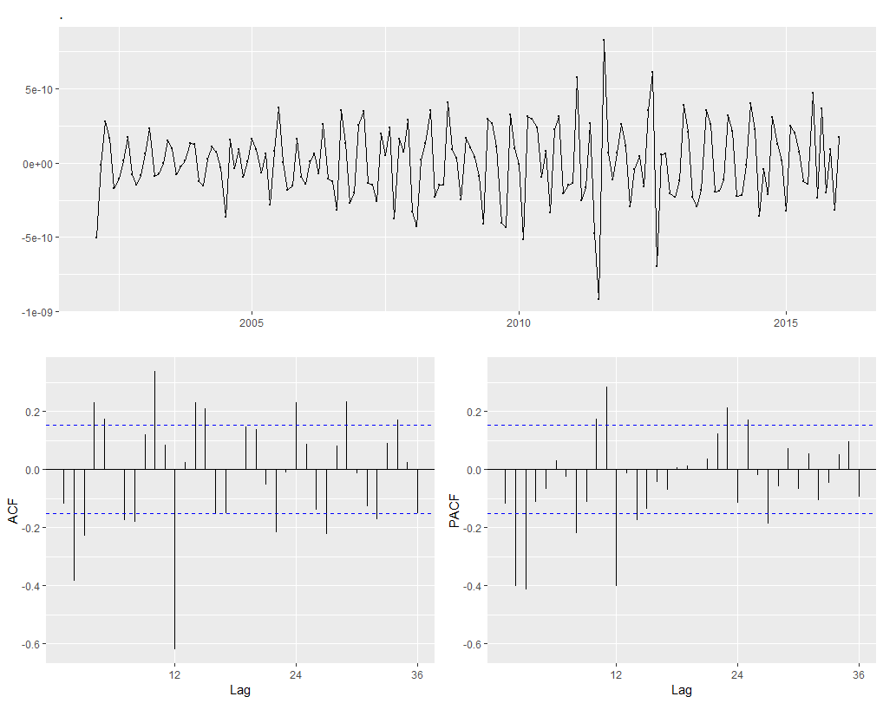
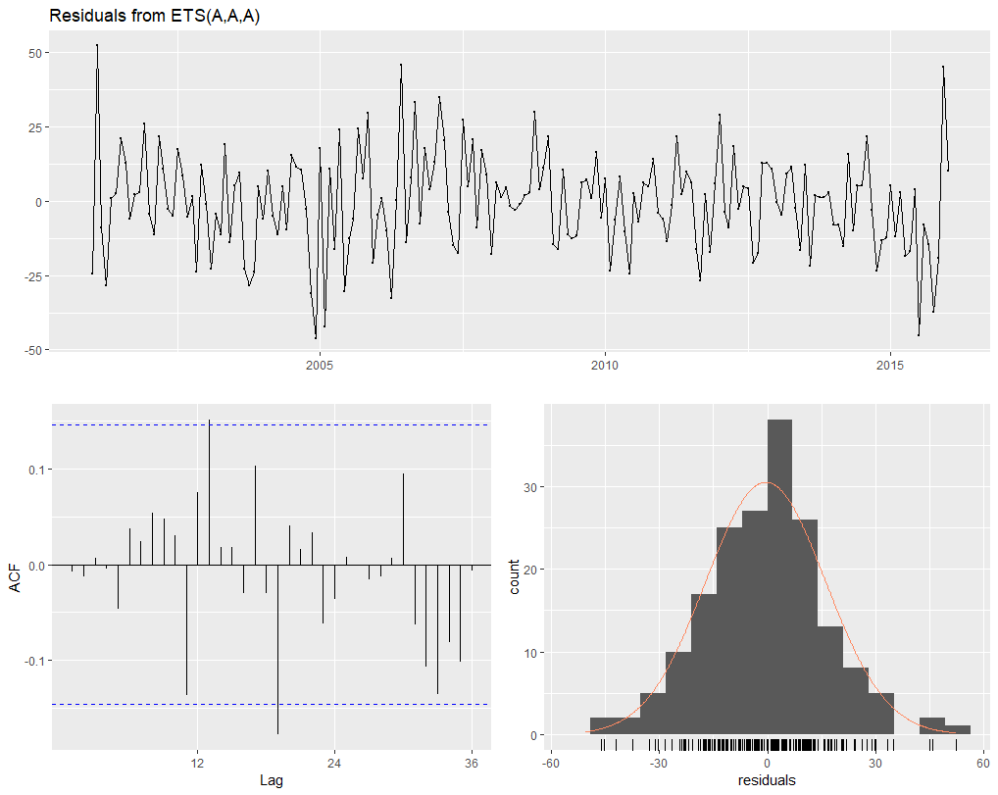
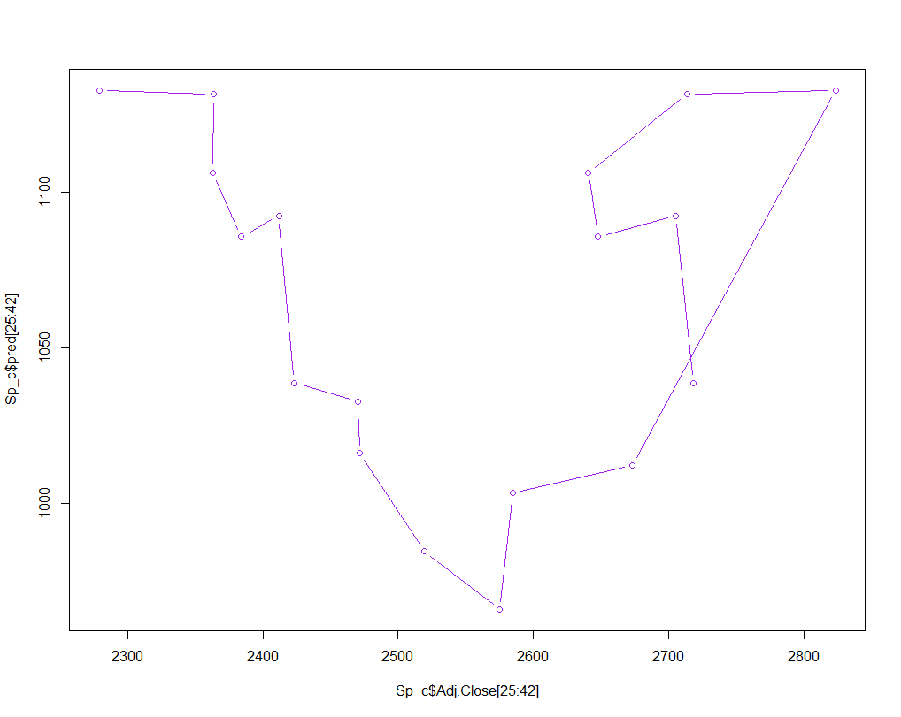
Time Series Analysis on market performance
Target: Find out whether stock market obeys time series
Approach: ets model, seasonal naive model, Arima model
S&P500 Index: Trading Volume: correlation between prediction and reality is < 0.3

Slide 4
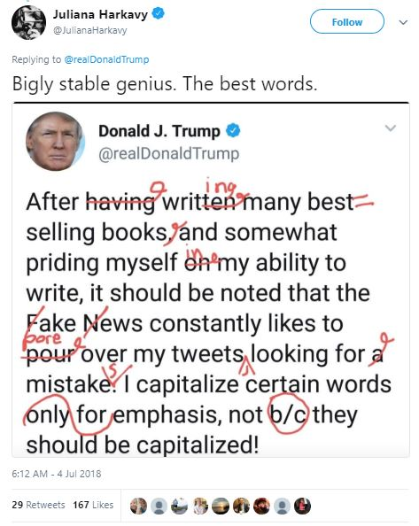
Sentiment Analysis on Twitter Tweets
Challenges:The problems facing microblogging sentiment analysis:
Data quality, Understanding and analyzing emoticons and slangs, Emojis
Comprehending Figurative Speech,
Subjectivity and Tone,
Context and Polarity,
Irony and Sarcasm,
Emphasis of ALL CAPs or multiples !!!!!
Comparisons,
Defining Neutral
Solution = VADER Lexicon (Valence Aware Dictionary and sEntiment Reasoner)
Notes:
Given all the use cases of sentiment analysis, there are a few challenges in analyzing tweets for sentiment analysis. The first one is data quality. The Twitter application helps us in overcoming this problem to an extent.
After basic cleaning of data extracted from the Twitter app, we can use it to generate sentiment score for tweets. The second problem comes in understanding and analyzing slangs used on Twitter.
Answer
People have a different way of writing and while posting on Twitter, people are least bothered about the correct spelling of words or they may use a lot of slangs which are not proper English words but are used in informal conversations.
There is a lot of research going on in this area and a lot of people have been able to develop slang dictionaries to understand their meaning. We won’t be focusing on this part in this article; we will use the standard dictionaries and packages available in R for sentiment analysis.
The third and the biggest problem in sentiment analysis is decoding sarcasm. Since sentiment analysis works on the semantics of words, it becomes difficult to decode if the post has a sarcasm.

Slide 5
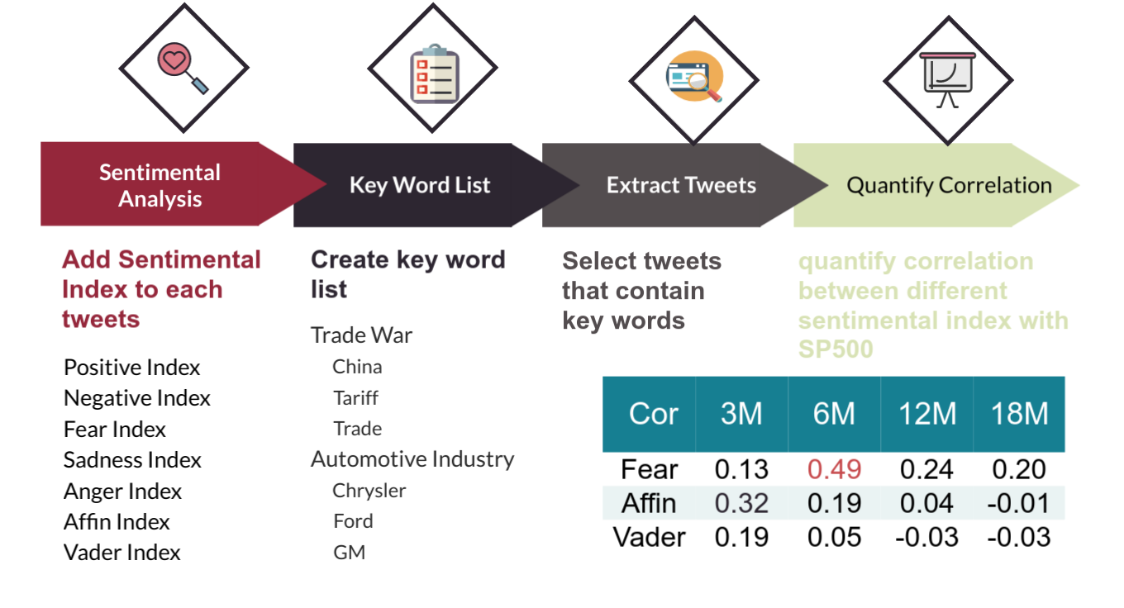
Correlation between tweets sentiment and SP500
Notes:
To quantify the relationship between tweets’ sentiment and financial market , we tried to calculate the correlation between them.
Firstly, we conduct sentimental analysis on all Trump’s tweets and add sentimental index to those tweets.
Then we create several key world list and extract those tweets that contain the key words. Since we may have too few tweets to do analysis if we use one key word. We choose the high frequency word that appear in relevant topics as our key words.
Lastly, we calculate the correlation between them and found the correlation is really weak. In this graph we can see only when window of time is 6 month, there is a moderate correlation between fear index and SP500.
Moreover, correlation doesn't ensure cause and effect, so we also did causal impact analysis.

Slide 6
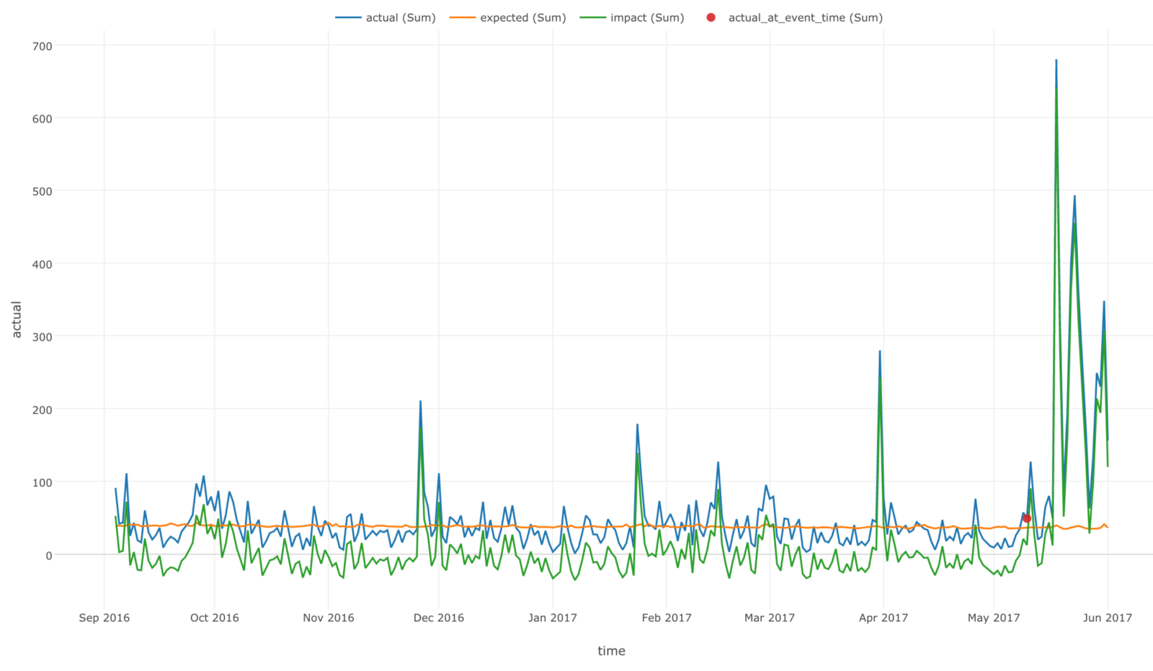
Causal Impact
Do the tweets influence the stock prices of individual company?
Except the “Fake news”
How about “America First”?
A package developed by Google
Constructs a Bayesian structural time-series model
Assess the impact of a particular event
Compares a response times series with a control times series

Slide 7
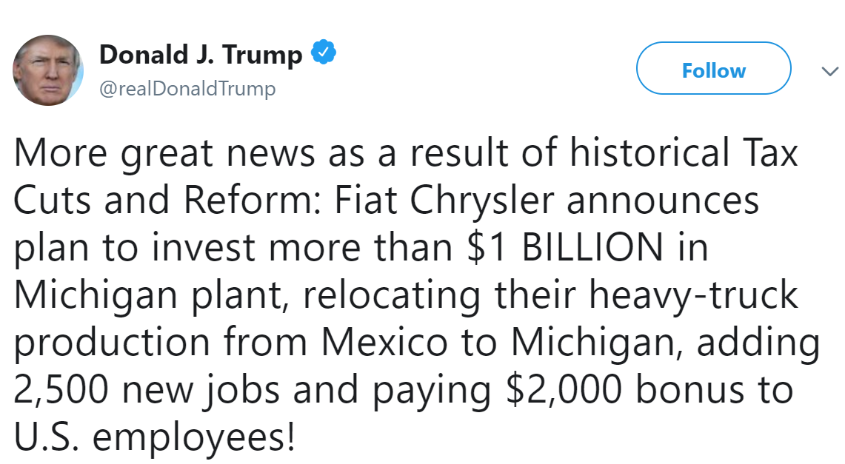
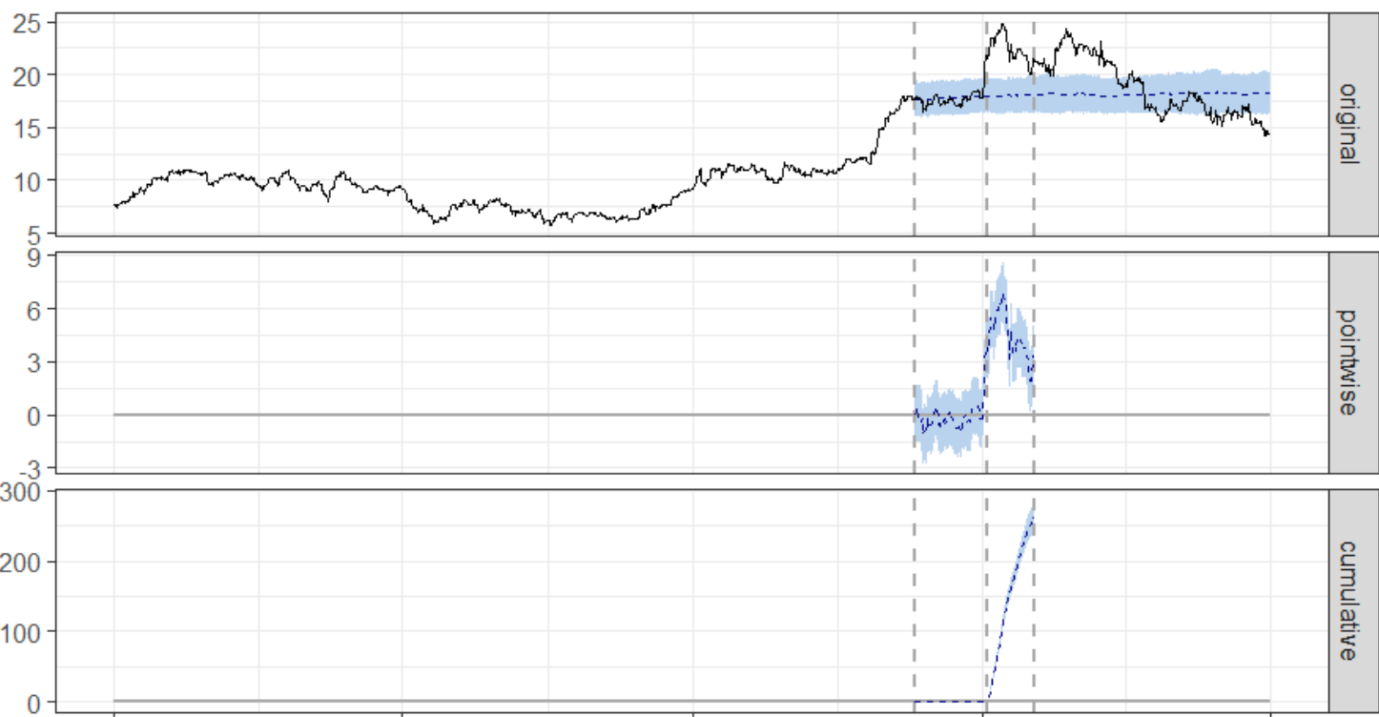
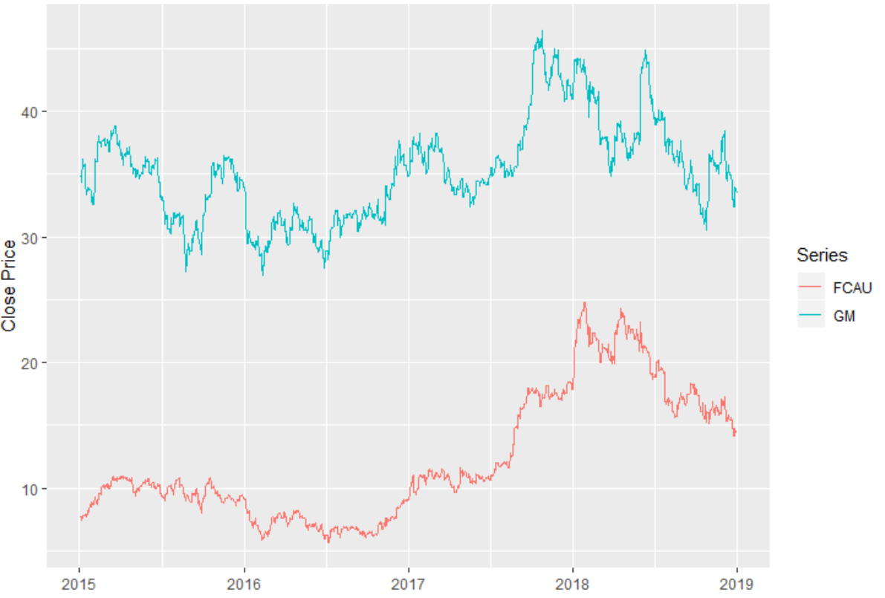
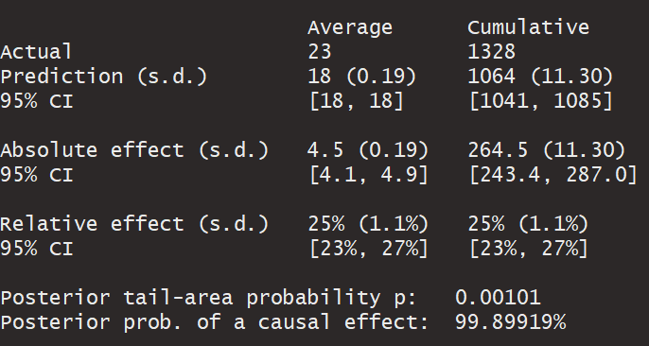
Chrysler Fiat vs. General Motors

Slide 8
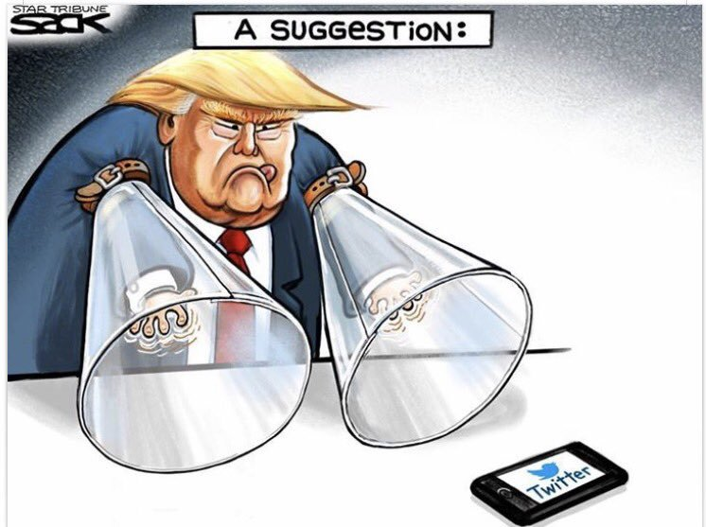
Conclusions:
Our analysis helps confirm the causal impact a single individual can have on organizations for the better or the worse. In addition, the Causal Impact also shows that Trump’s tweets impact stock price of Chrysler, Toyota, and Pfizer. As a result, regulators may want to consider pursuing the effect of influential Twitter users on financial markets more critically in the future.

